Slide 1

Maximum Likelihood Sequence Estimation from Lattice Viewpoint
Presenter : Saifur Rahman
Communication Theory Lab
Course: ENGR 553 Signal Estimation Theory Project
Instructor : Dr. Jahangir Hossain

Slide 2
Motivations…..
Research Initiation: ‘’ Viterbi Algorithm’’
Literature objective
Related Literature
Improvisations in this project….

Slide 3
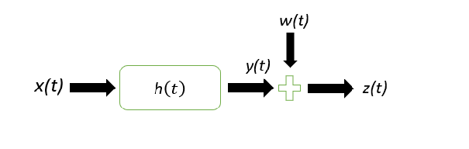
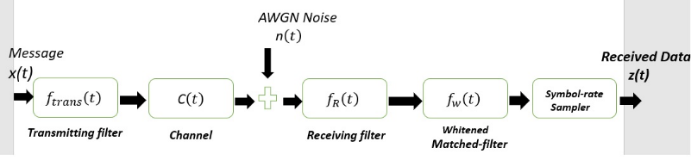

Discrete Time Channel Model
Convolutional encoder
ISI distortion
State dependence on the channel
Discrete Time Channel Model
$${ y}_{i}=h_{o} x_{i}+\sum_{j=1}^{v}{h_{j}}x_{\left(i−j\right)}$$
Data Transmission

Slide 4
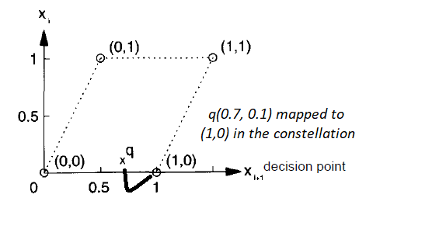
Problem Enunciation
Nearest Lattice Point Problem (NLP)
Enumeration Algorithm
Lattice Interpretation of 2-D MLSE

Slide 5
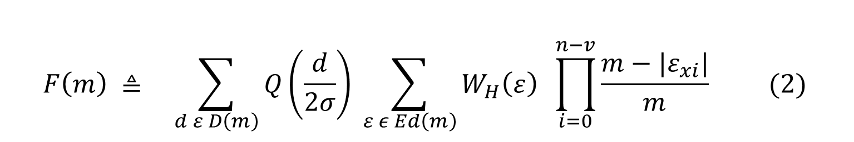
SEP Formulation
${ SEP}_{LSE} ≤ \lim_{m → ∝}{ \sum_{d ε D\left(m\right)}{Q\left(\frac{d}{2σ}\right)} \sum_{ε ε Ed\left(m\right)}{W_{H}\left(ε\right) (1) }}$
$$F\left(m\right) ≜ \sum_{d ε D\left(m\right)}{Q\left(\frac{d}{2σ}\right)} \sum_{ε ε Ed\left(m\right)}{W_{H}\left(ε\right) \prod_{i=0}^{n−v}{\frac{m−|ε_{xi}|}{m}} (2) }{ }$$
${ SEP}_{LSE} ≤ \lim_{m → ∝}{F\left(m\right)\sim \lim_{m→∝}\left.Q(\frac{\left.d_{min}(m\right)}{2σ}\right) \sum_{ε ε Ed\left(m\right)}{W_{H}\left(ε\right) (3) }}$

Slide 6
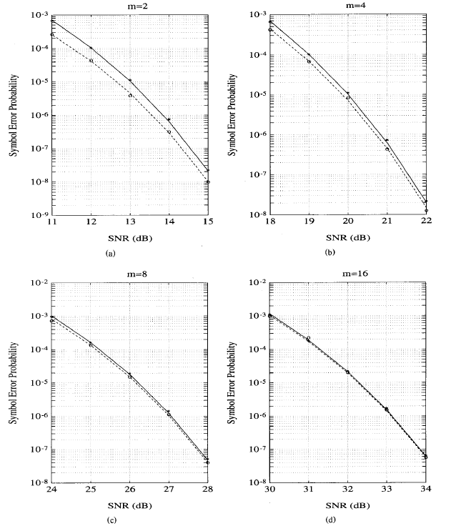

Literature Objective
Optimal $≥$ m=8
SNR gap decreases for higher modulation order
Boundary error decreases as $′m \& SNR^{′} increases$

Slide 7
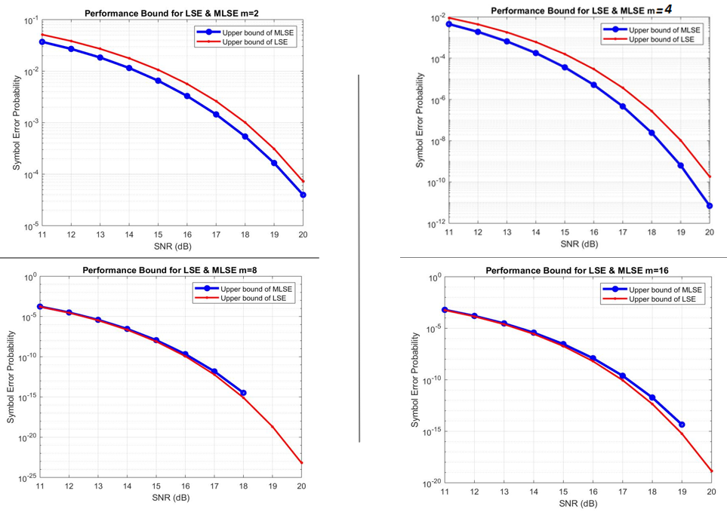


MATLAB Simulation of Performance Bound
Tight upper bound $m≥8$
Upper bound of LSE & MLSE coincides for higher $order ′m′$
LSE & MLSE for m={2,4,8,16}, $δ=10$, N= 1000

Slide 8
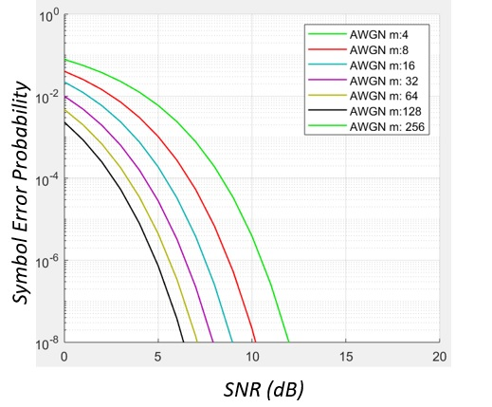


MATLAB Simulation: AWGN
$′m′ increases SEP drops$ sharply
under same channel constraint
AWGN : $′m′=\{ 4, 8 , 16 , 32 , 64 , 128 , 256 \}$

Slide 9
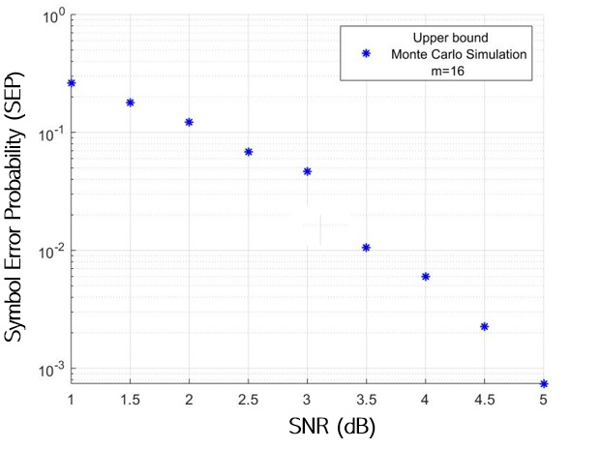


Monte Carlo Simulation
Channel impulse response $′h′$ -complex
Single-discrepancy at SNR = 3dB
LSE- SEP Upper bound {$′m=16′$ } with the complex channel response

Slide 10
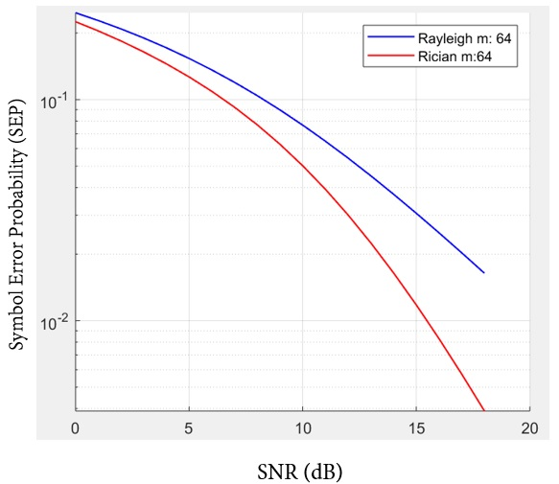

MATLAB Simulation: Rayleigh & Rician Channel
Channel impulse response $′h′$ -complex
Single-discrepancy at SNR = 3dB
MATLAB simulation of Rayleigh & Rician Channel {$′m=64^{′}$}

Slide 11
Project’s Scope
extended to different channel impulse response
classify channel for which F(m) exists
investigate effect of truncation depth ‘δ’ on SEP

Slide 12
References:
Fincke, U., & Pohst, M. (1985). Improved methods for calculating vectors of short length in a lattice, including a complexity analysis. Mathematics of Computation, 44(170), 463–463. doi: 10.1090/s0025-5718-1985-0777278-8
Mow, W. H. (n.d.). Performance of the lattice sequence estimator. Proceedings of 1994 IEEE International Symposium on Information Theory. doi: 10.1109/isit.1994.394796
Mow, W. H. (1994). Maximum likelihood sequence estimation from the lattice viewpoint. IEEE Transactions on Information Theory, 40(5), 1591–1600. doi: 10.1109/18.333872
Forney, G. (1970). Convolutional codes I: Algebraic structure. IEEE Transactions on Information Theory, 16(6), 720–738. doi: 10.1109/tit.1970.1054541
Farhang-Boroujeny. (1995). Channel memory truncation for maximum likelihood sequence estimation. Proceedings of GLOBECOM 95 GLOCOM-95. doi: 10.1109/ctmc.1995.502954.

Slide 13
Thank You

